Slide 1
Facebook Page and ADS campaigns

Slide 2
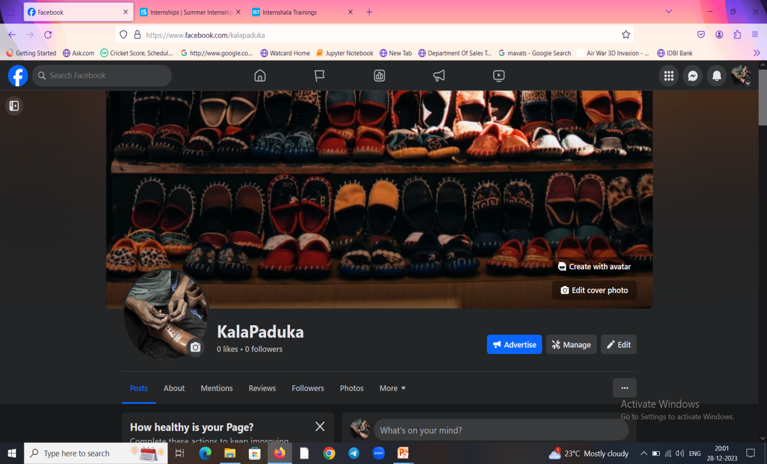
Facebook Store Name: KALAPADUKA

Slide 3
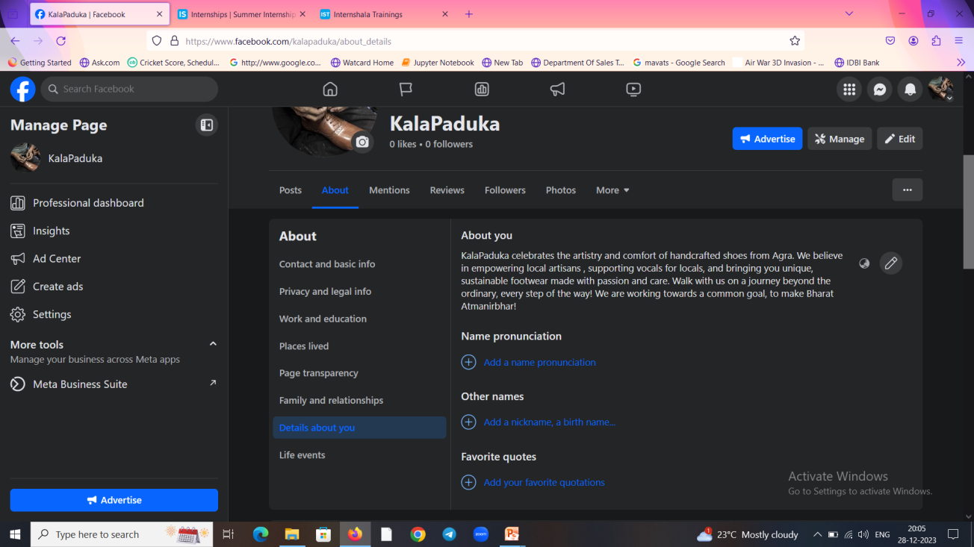
“About” My Facebook page:

Slide 4
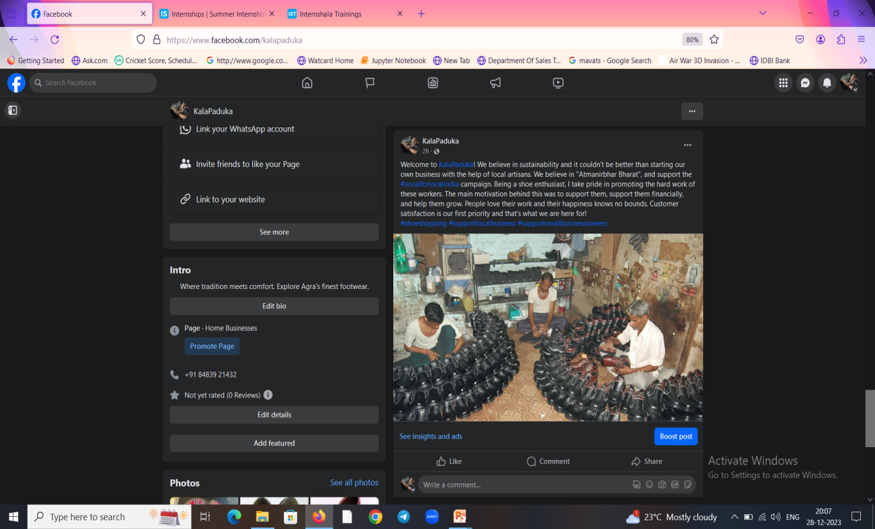
Motivation Behind the page:

Slide 5
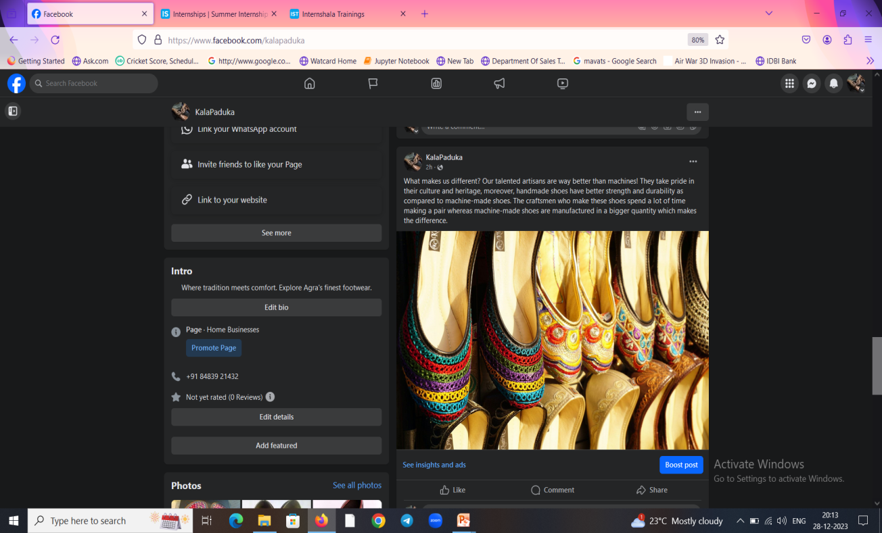
What sets us apart?

Slide 6
Let’s delve into products:

Slide 7
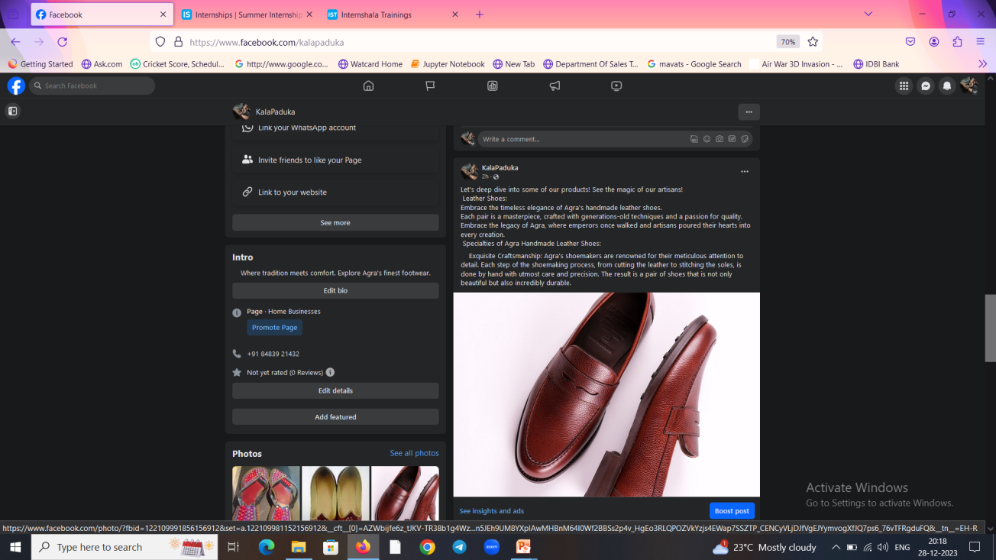
1.Leather shoes

Slide 8
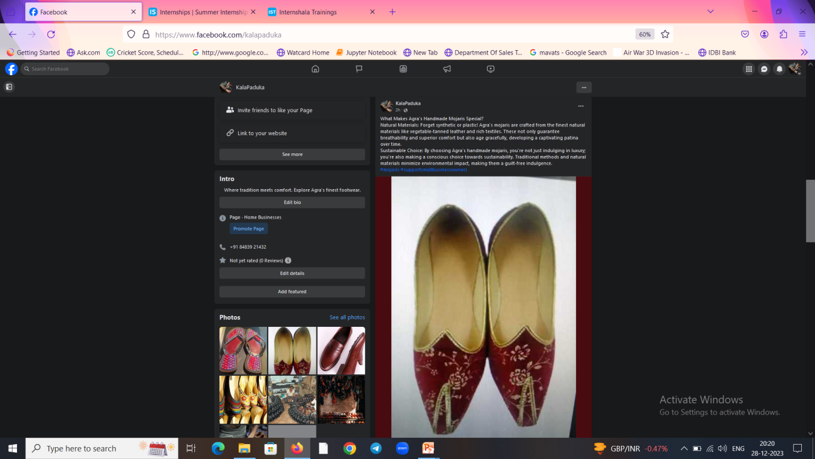
2.Mojoris

Slide 9
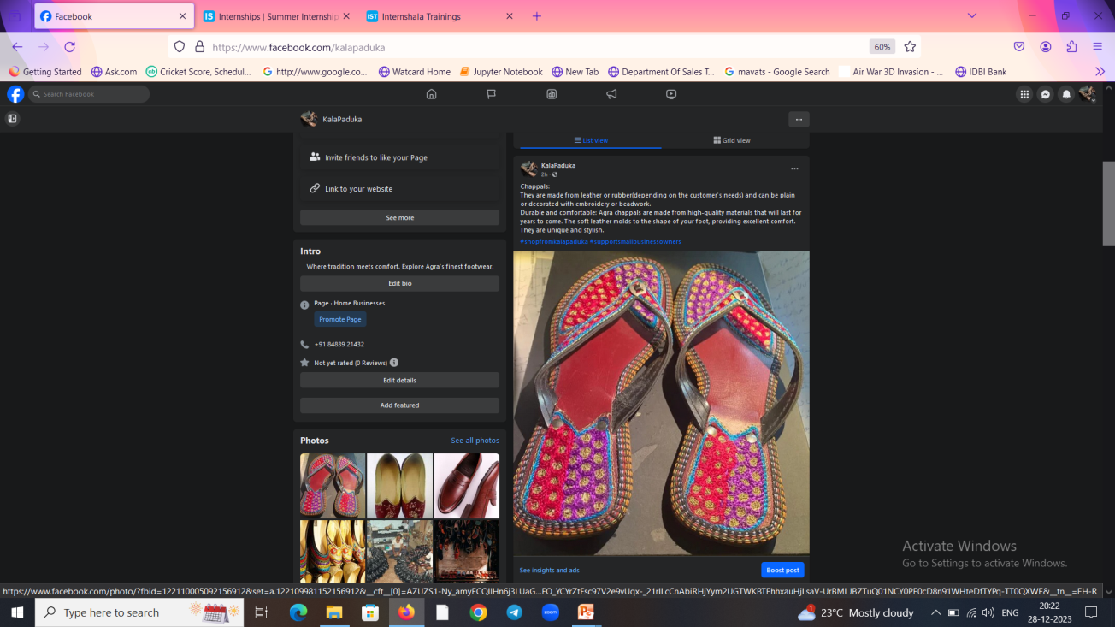
3.Chappals

Slide 10
Facebook Page link:
https://www.facebook.com/kalapaduka

Slide 11
Facebook ads campaign

Slide 12
Plan to create Facebook ads and the reason behind it
1)Awareness Campaign: Firstly, as our business is new we need to run brand awareness campaign so that people will get to know about our business and its speciality. (Objective:Reach)
2)Website Traffic: Then we will run website traffic campaign so that maximum people visit our Facebook shop, where customers can learn about our products and resulting in purchase. (Objective:Traffic)

Slide 13
Target audience:
Awareness Campaign:
Age 25-55
Location: Agra and surrounding areas
Interests: Fashion, Footwear, Sustainable Products.
Lookalike Audience list may be created which we know who are likely to make purchase.

Slide 14
Website Traffic/Shop traffic Targeting
Age 25-55
Location: Agra and surrounding areas
Interests: Fashion, Footwear, Sustainable Products.
Retargeting: We need to target those people who have had already visited our shop or interacted with some previous ads/posts.

Slide 15
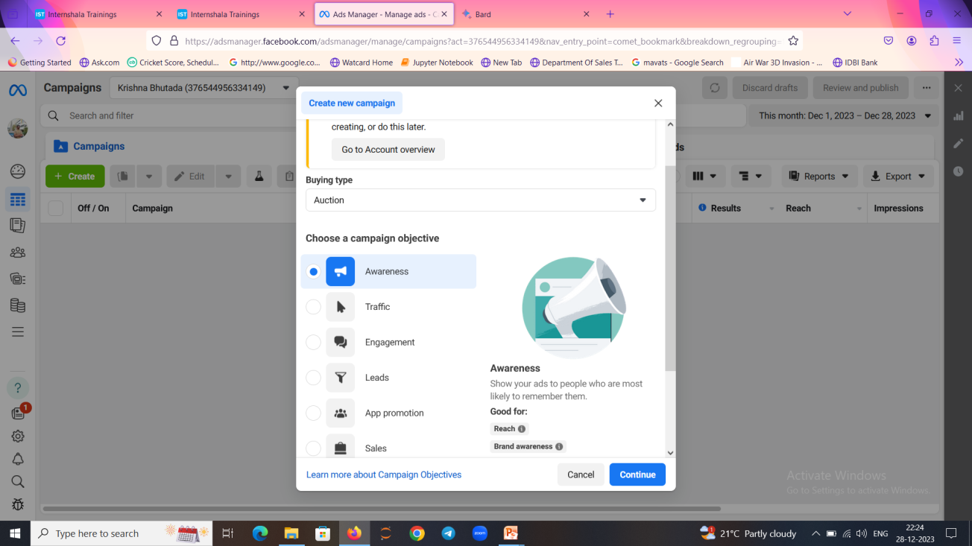
1)Awareness campaign:

Slide 16
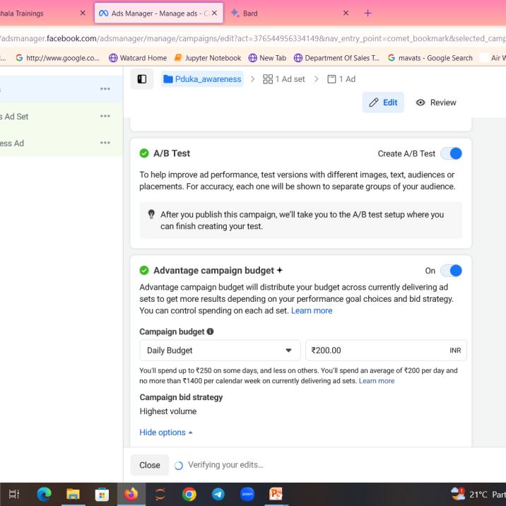
Bidding strategy:
As our main aim is to reach maximum people ,we have chosen campaign bid strategy as “Highest Volume”

Slide 17
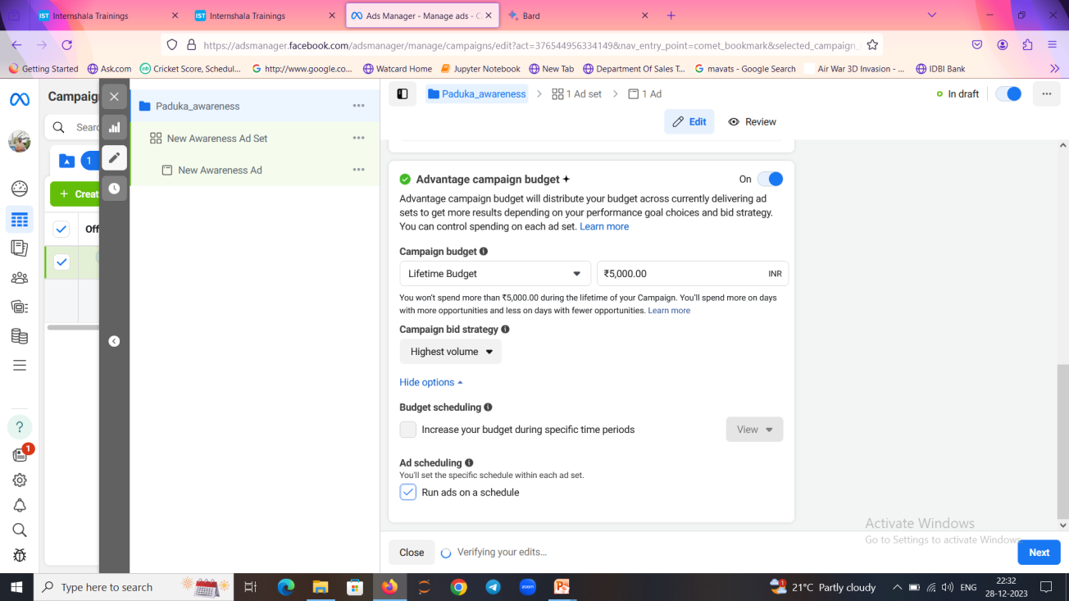
Maximum Lifetime Budget

Slide 18
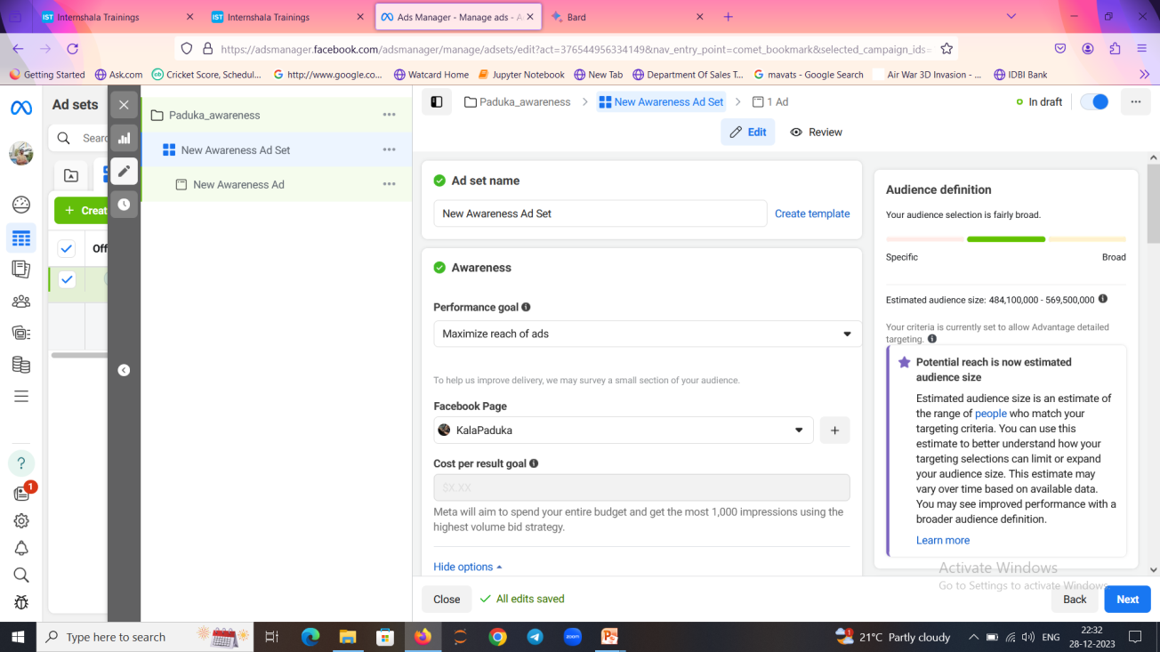
Maximum Performance Goal

Slide 19
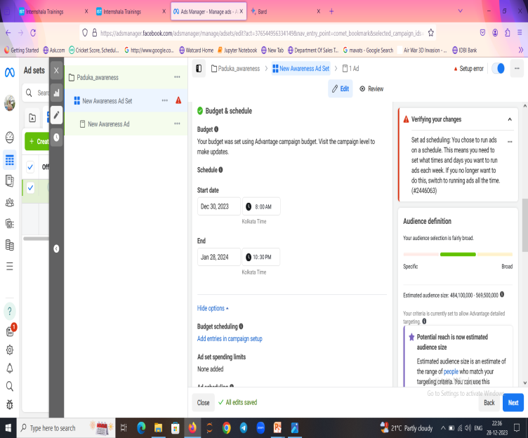
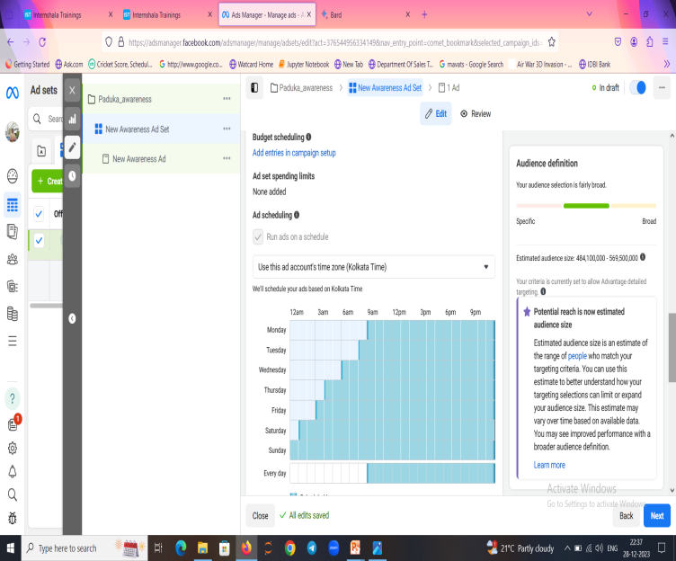
Budget and schedule:

Slide 20
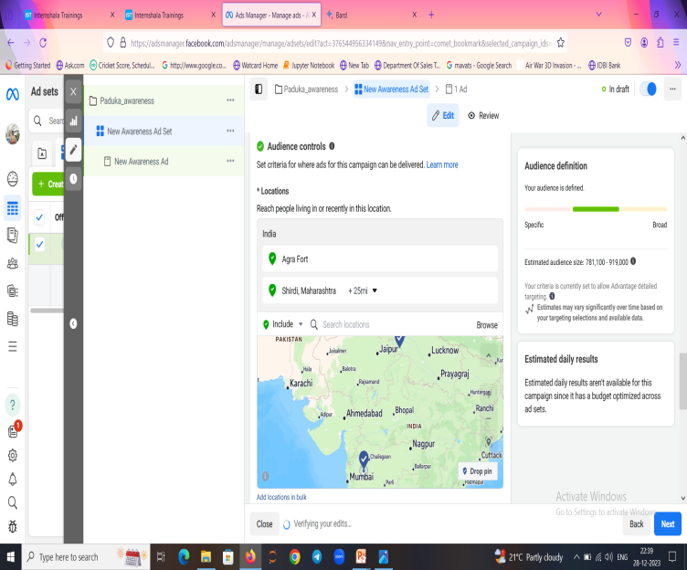
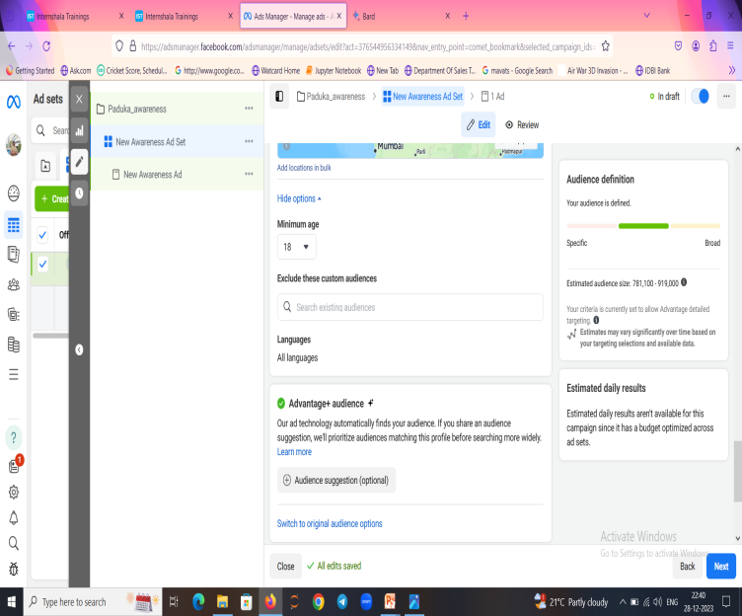
Demographics and regions:

Slide 21
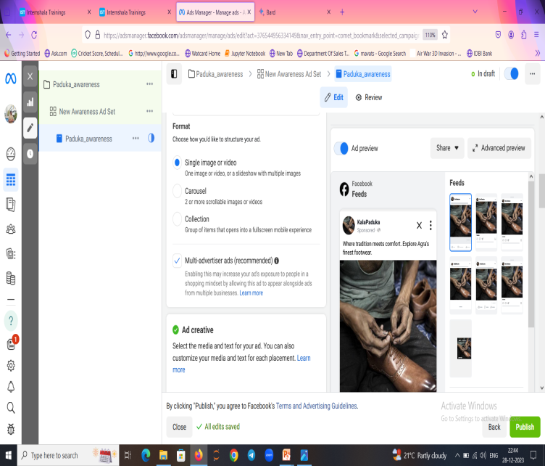
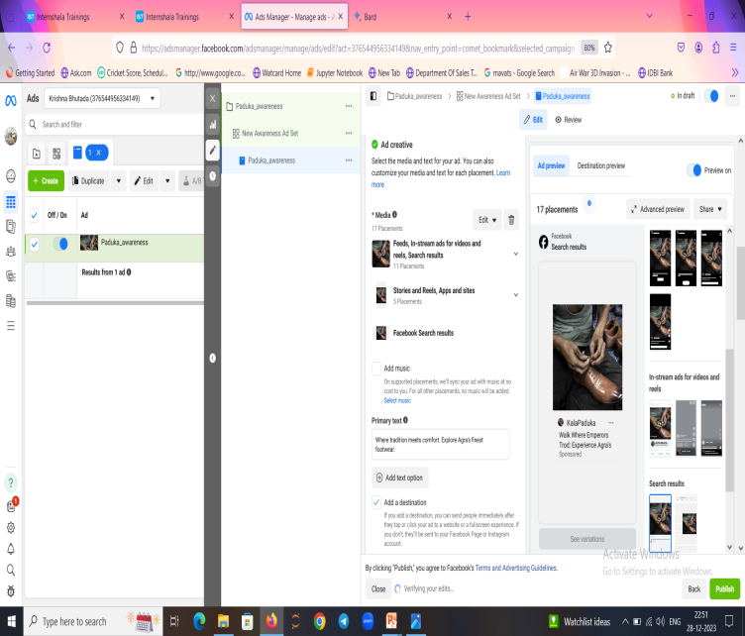
AD CREATIVES:

Slide 22
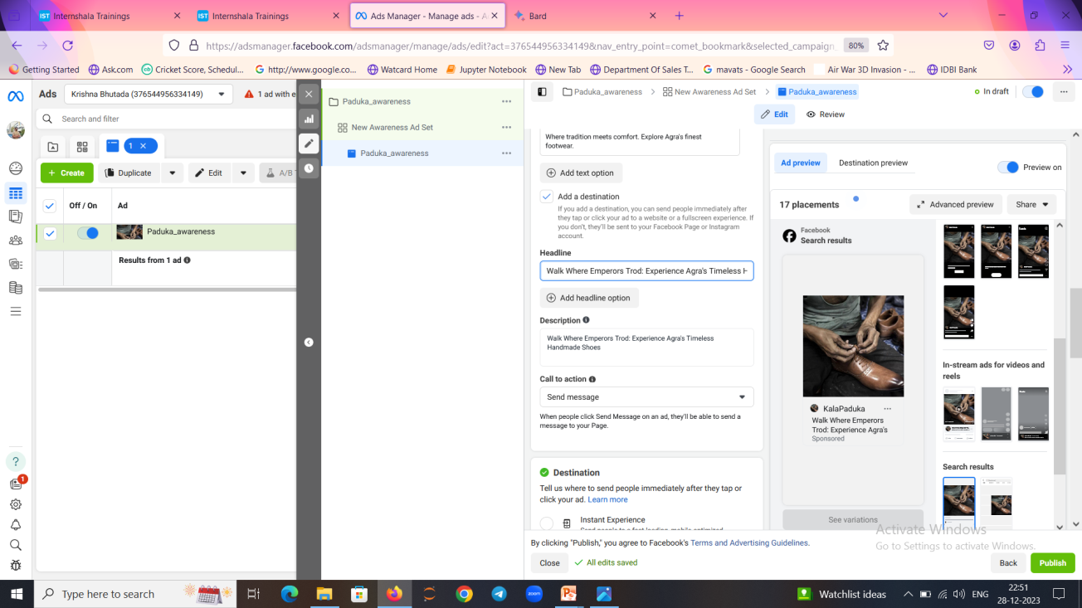
Headlines:

Slide 23

Call to action:

Slide 24
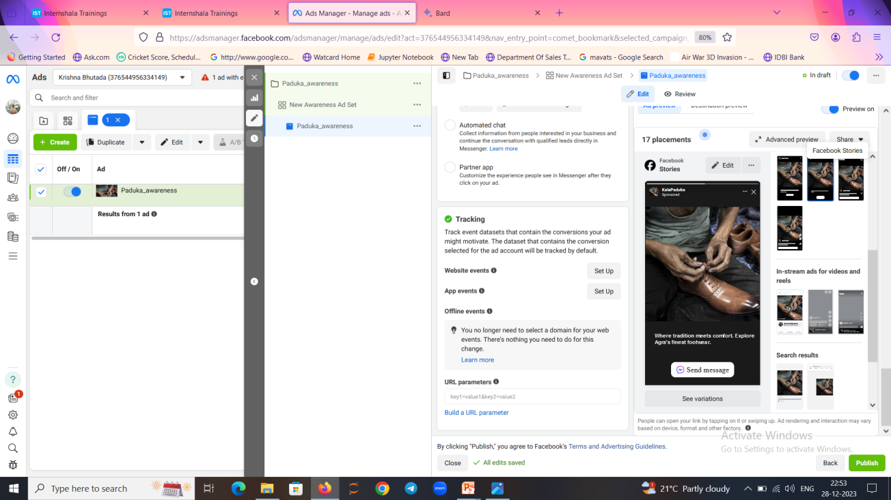
How call to action looks

Slide 25
2.TRAFFIC AWARENESS:

Slide 26
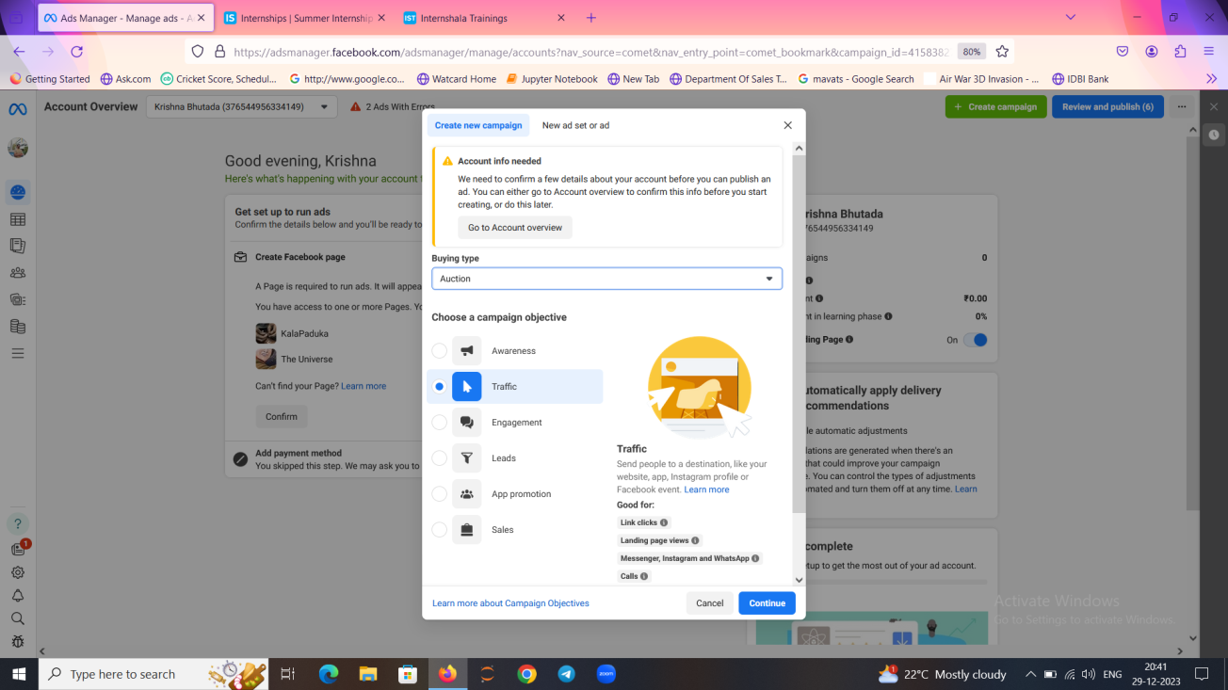
Traffic campaign:

Slide 27
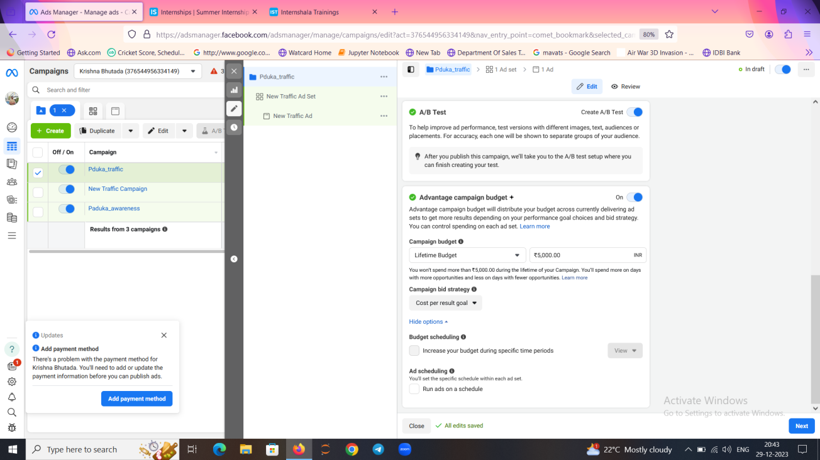
Bidding Strategy:

Slide 28
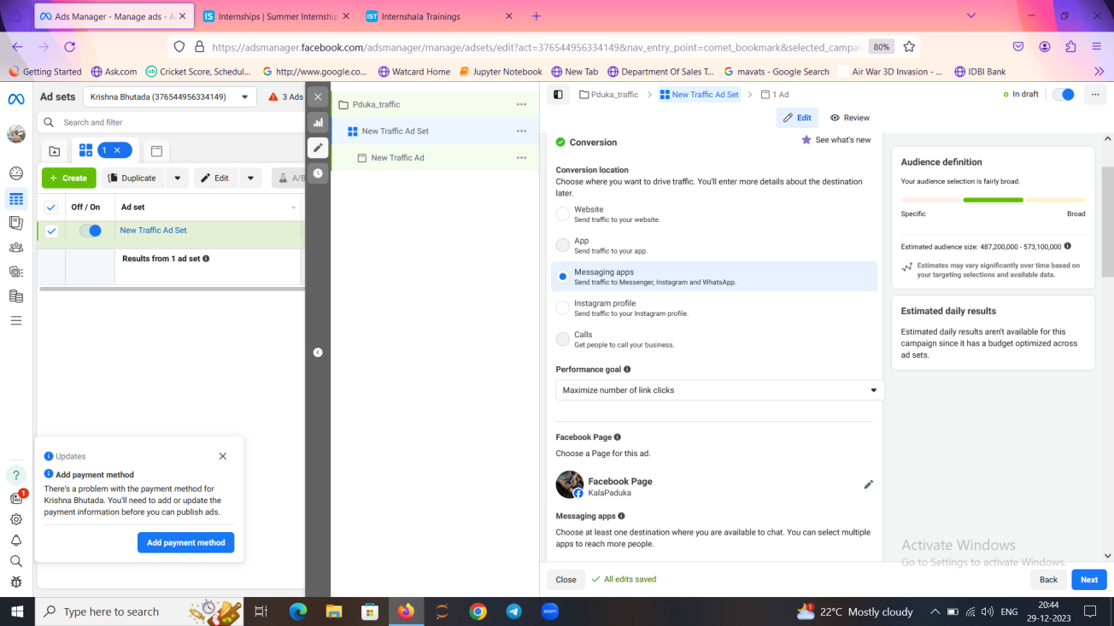
Performance goal and conversion

Slide 29
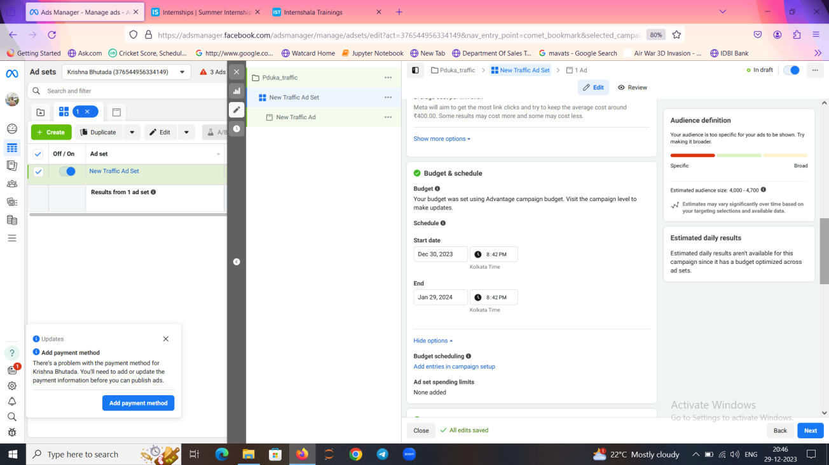
Budget and scheduling:

Slide 30
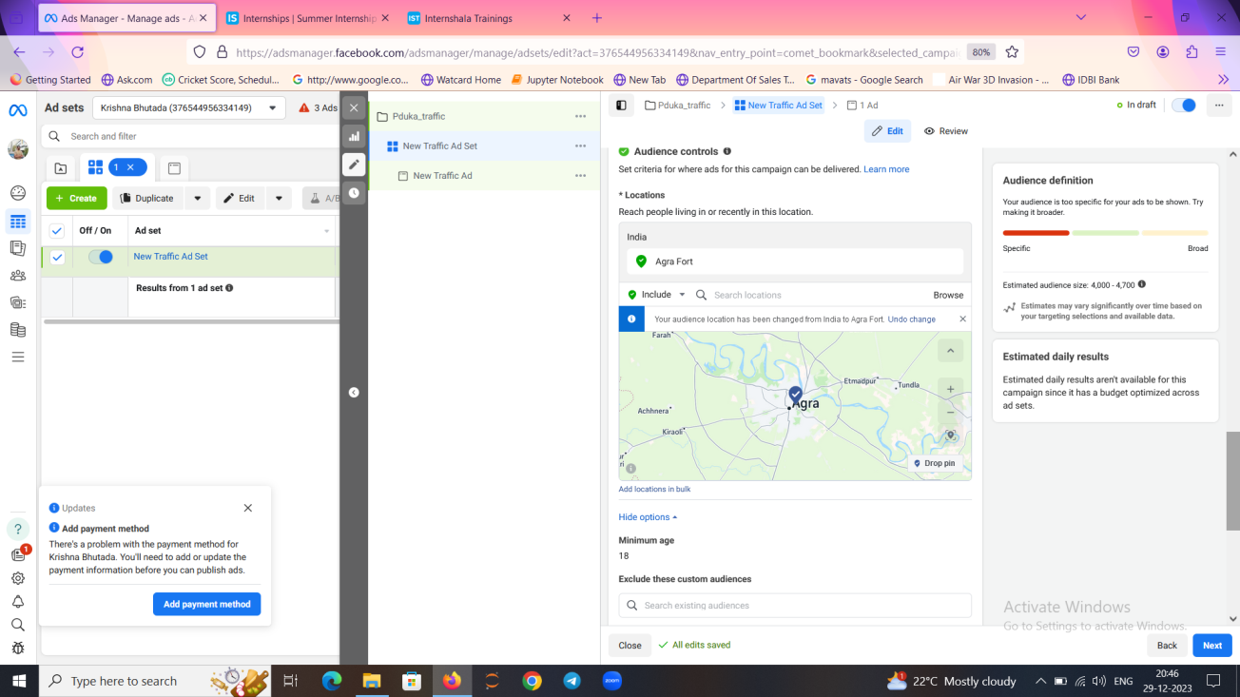
Region targeting and demographics:

Slide 31
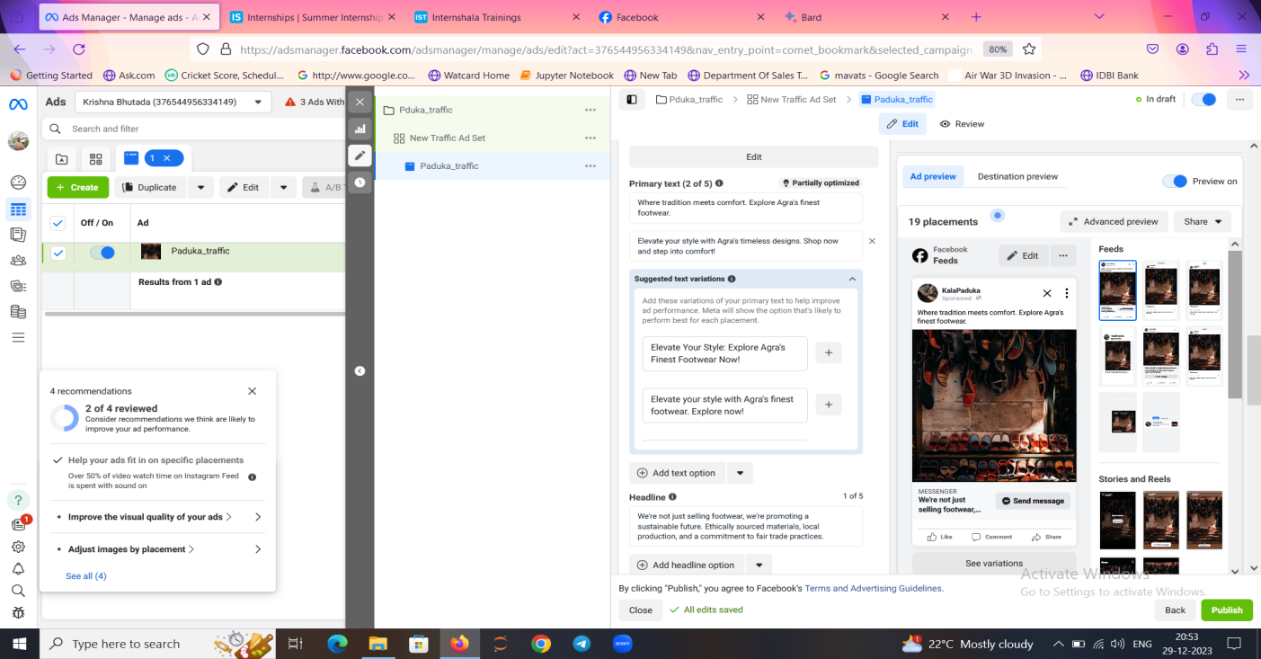
AD CREATIVES:

Slide 32
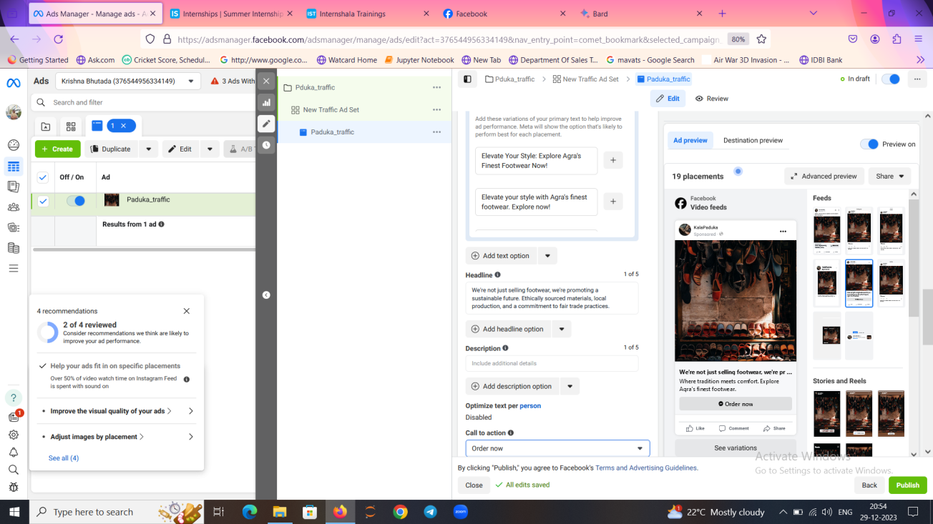
HEADLINE:

Slide 33
Call to action:

Slide 34
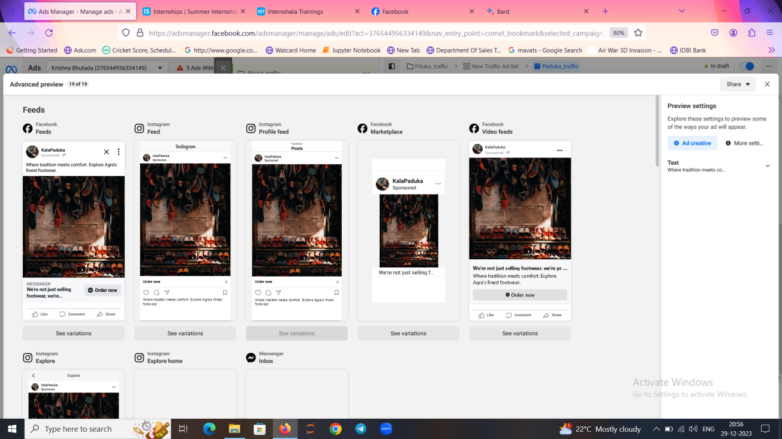
AD CREATIVE ADVANCED PREVIEW

Slide 35
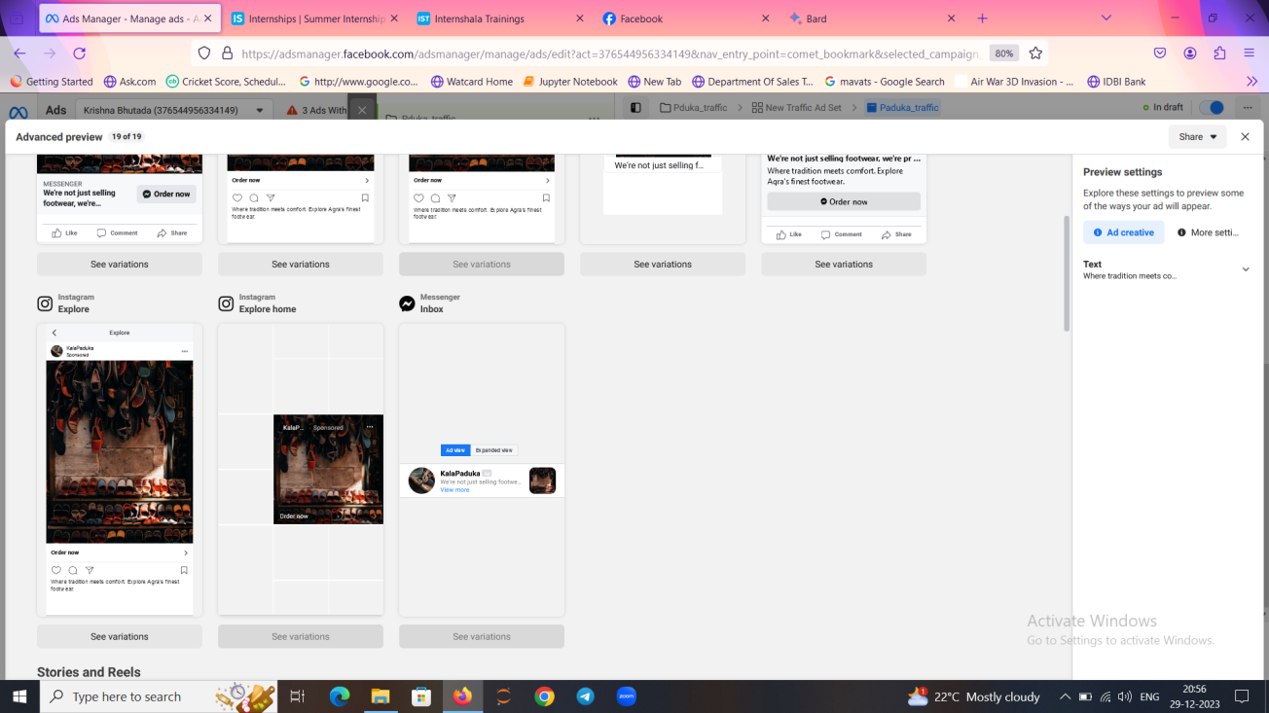
Facebook Messenger view:

Slide 36
Analysis:
1)Maximum budget will be allocated to awareness campaign as the main aim is to reach maximum people and gradually shift the budget to traffic campaign.
2) Analysis which ad creatives and targeting options perform best will be done using A/B testing and then decide the future strategy which campaign resonates better with the target audience.

Slide 37
Conclusion:
Thus, as most of the people are using facebook, it serves as the great medium to build our business by running ads which is way more effective than organic leads.
Thus, social media marketing plays a crucial role in building our brand digitally and we can reach maximum people in a short span of time. That’s the advantage of being DIGITAL!

